Slide 1

Queue Management System

Slide 2
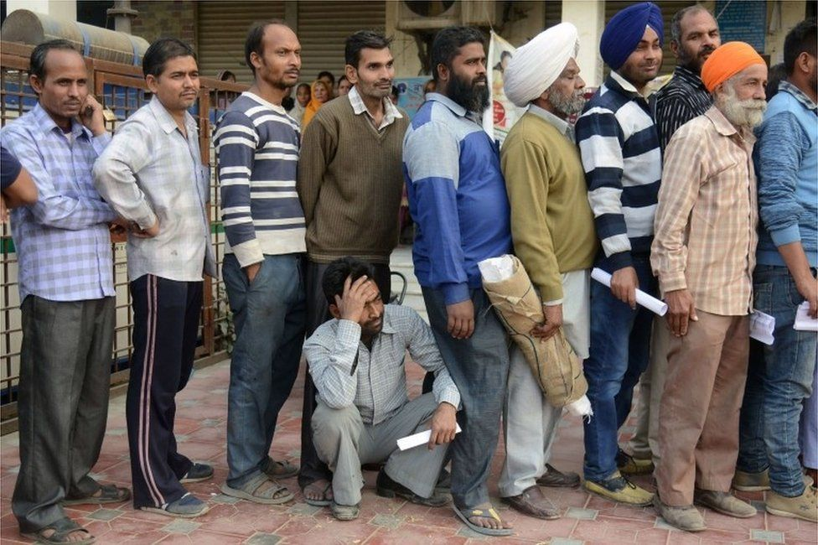
No more long queues

Slide 3

All u need to do is book an appointment from home and come to place 10 min earlier

Slide 4
Presenting u the queue management app
(Insert first window of program after adding background)

Slide 5
Main idea of the project

Slide 6
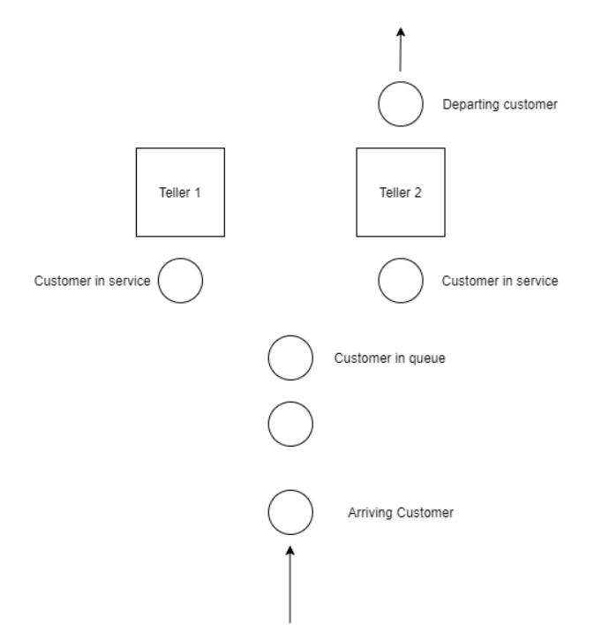

Slide 7
Project is mainly divided into two parts

Slide 8
Arrival

Slide 9
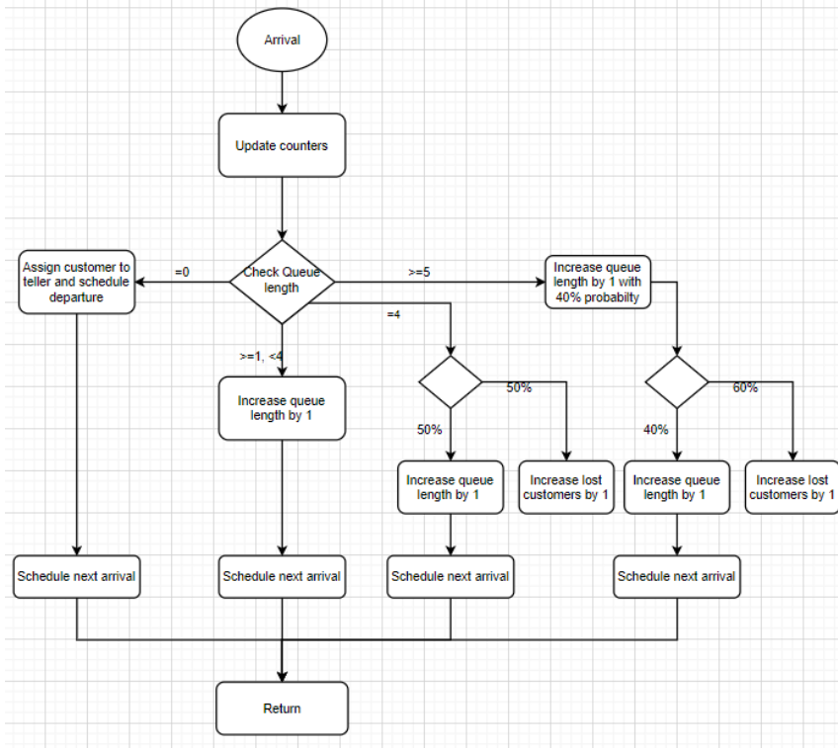

Slide 10
Departure

Slide 11

